Slide 1
Water level indicator with alarm
J.A.S. UPAMALI -CODSE213F-013
T.T. LIYANAARACHCHI - CODSE213F-013
R.A.D.H. SARANYA- CODSE213F-054
L.H.M. FERNANDO -CODSE213F-052

Slide 2
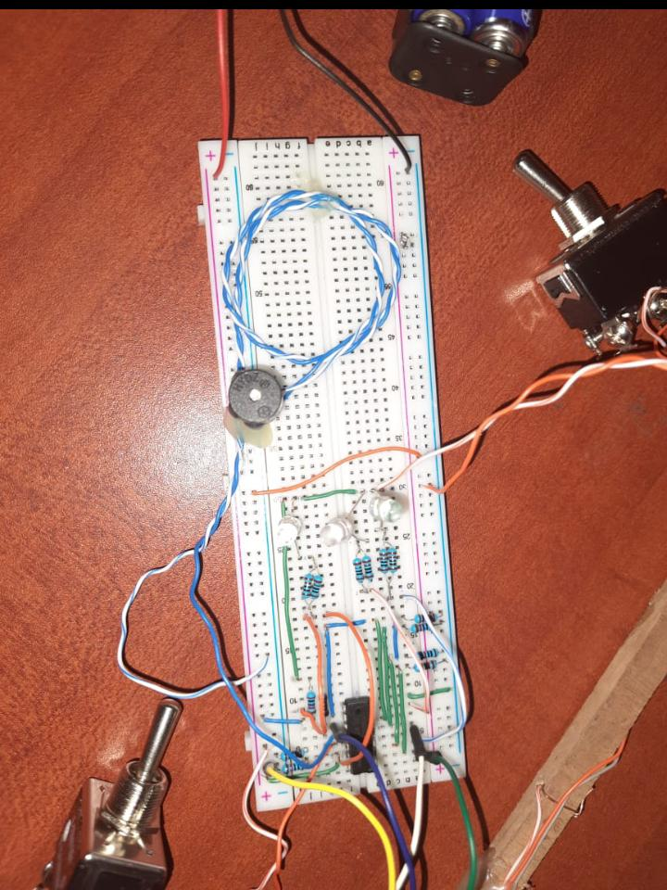

Slide 3
This is an electronic circuit designed to indicate the water levels of large-scale water tanks and an alarm system to prevent the water overflow from the tanks used in the agricultural industry. Our main intention was to develop a methodology to improve the agricultural sector by using the new technology and to achieve this task we have designed this electronic system

Slide 4
Features of the Product

Slide 5
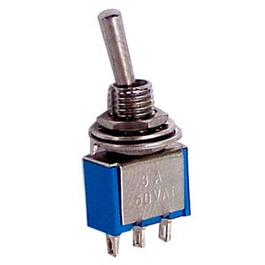
Switch for the LED light system
Purpose of the feature:
Turning off and on the light system manually when needed.
How it affects the system:
We can turn on the light system before switching on the water pump. In that way we can get to know the level of the water getting filled at that moment.
Similarly, we can turn it off when we don’t want to get the water level indication.

Slide 6
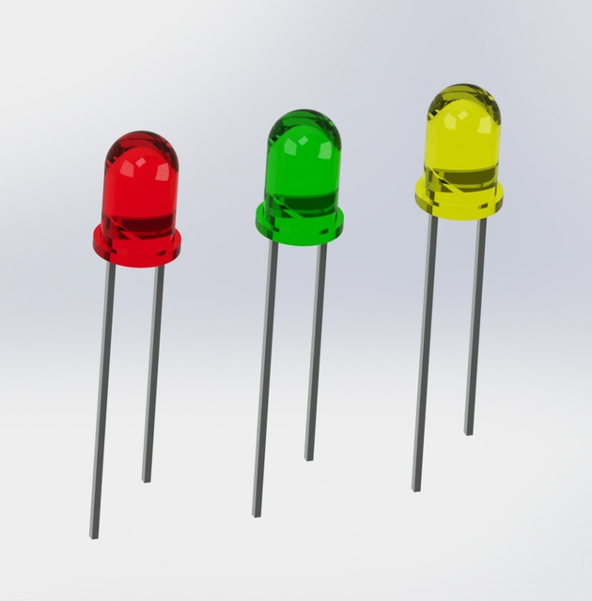
LED light system
Purpose of the feature:
Indication of the water levels of the tank using 3 LEDs selected from 3 standard universal colours red, yellow, and green respectively for high, mid, and low levels.
RED – HIGH LEVEL YELLOW – MID LEVEL GREEN – LOW LEVEL
How it affects the system:
When the water gets filled up to the relevant level the respective LED will glow.
And when the water is getting lowered from that relevant level the connected LED will stop its emission.

Slide 7
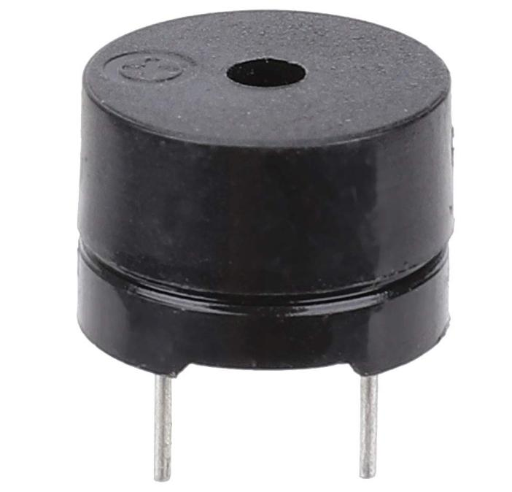
The buzzer
Purpose of the feature:
Indication of an alarm when the water from the tank is about to overflow.
How it affects the system:
This buzzer starts working when the pump is switched on and the water level is reached up to the high level at the same time. By turning the pump off we can prevent the water from overflowing.
This feature is helpful for the people with vision disabilities.

Slide 8

Portable rod
Purpose of the feature:
Get the exact water level from the tank
How it affects the system:
This rod is portable and no need to plant inside the water tank. So, we can use it in other tanks as well.
Since this is made up using wood it can be used in any liquid tanks to get the level indication.

Slide 9
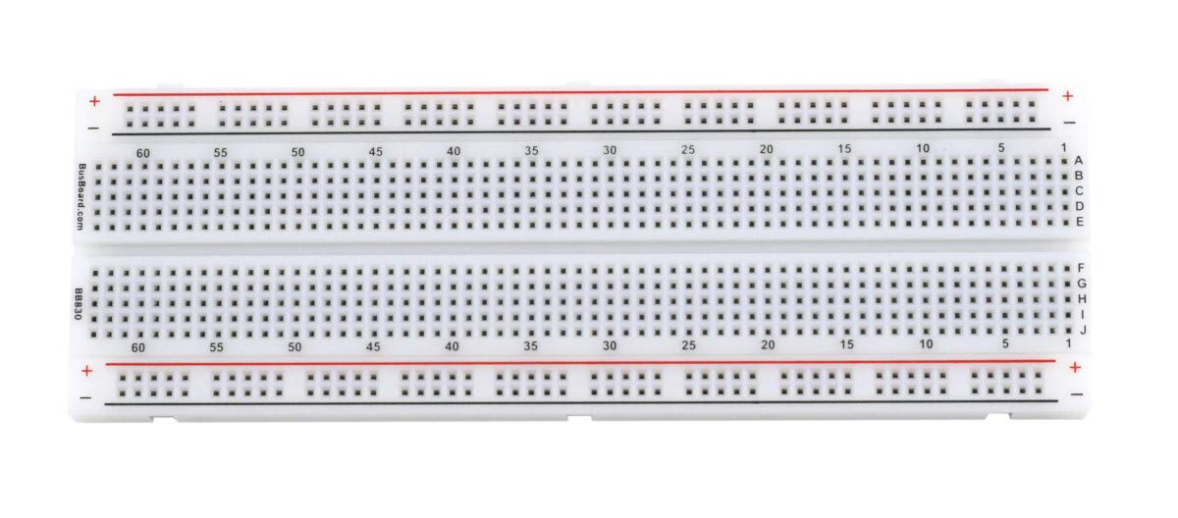
needed components Breadboard

Slide 10
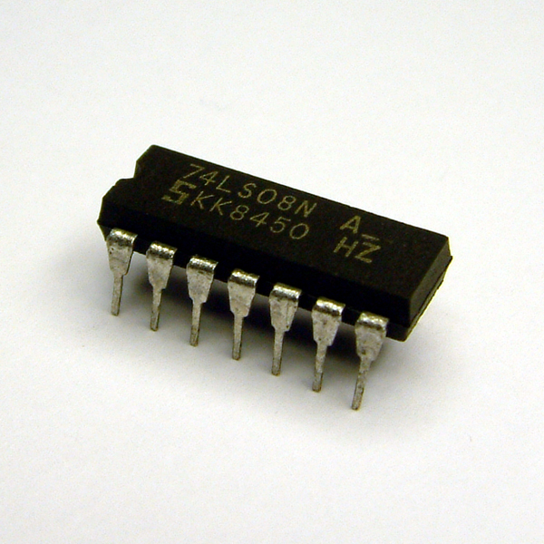
Integrated Circuit 7408
Integrated Circuit 7408

Slide 11
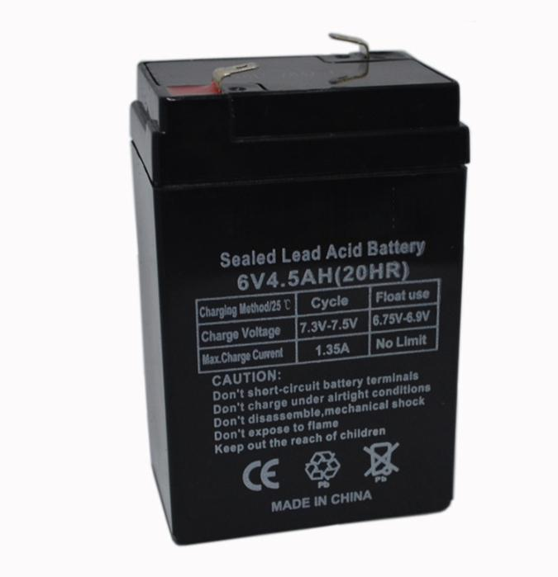
6V power supply

Slide 12
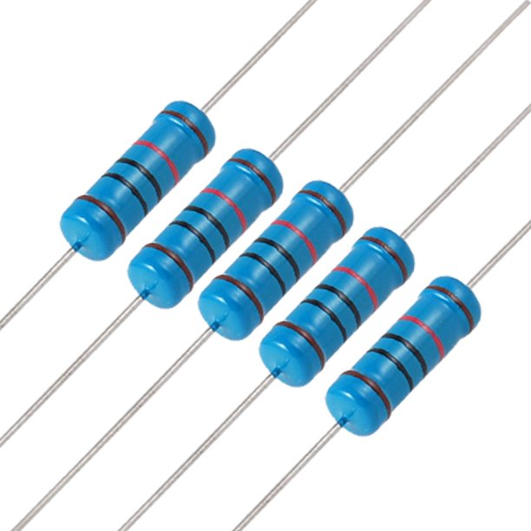
600Ω Resistors 10kΩ Resistors

Slide 13
3 LEDs from the colors red, yellow, and green

Slide 14
Buzzer

Slide 15
Switches

Slide 16
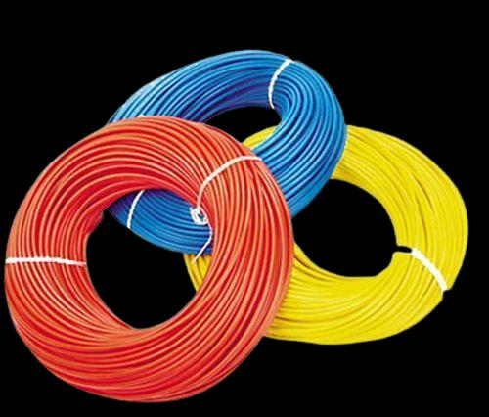
Circuit Wires

Slide 17
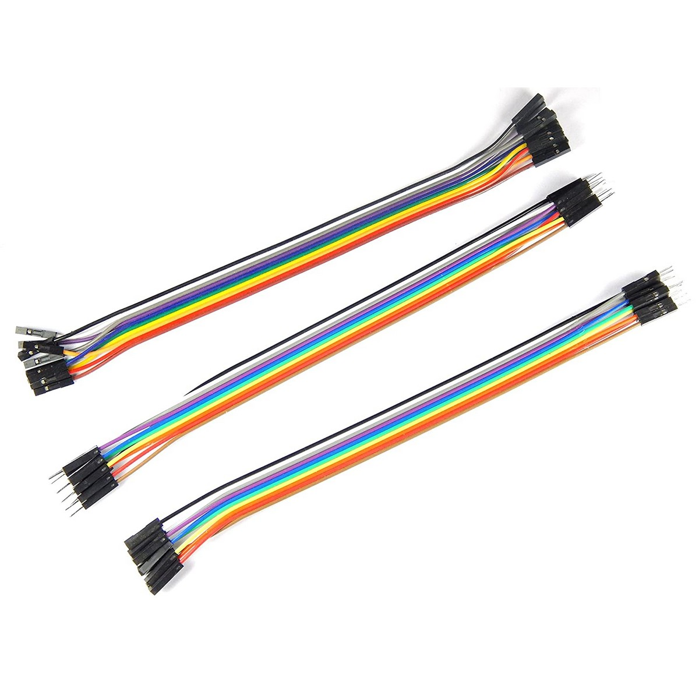
jumper cables

Slide 18
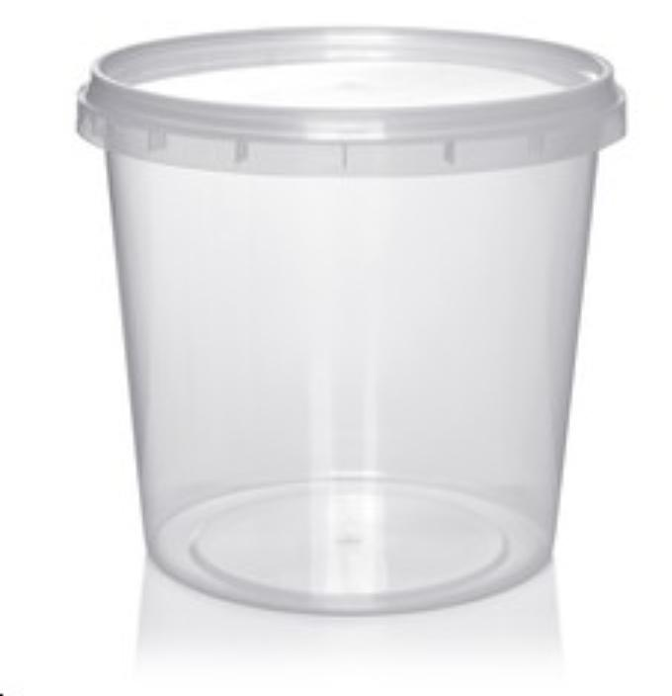
container

Slide 19
wooden rod

Slide 20
benefits of our system
We can Minimize or Eliminate water wastage and financial expenses for water
We can Minimize physical interventions for the process and saved time could be used for other work
This system will Increase the profitability of the business by reducing personal involvement and will minimize human errors
The price of the agricultural products can be reduced, and it is a relief to consumers and to the government
This will facilitate even for the people with hearing loss and vision loss

Slide 21
Limitations
The pump does not automatically shut off when the tank is full
Once the tank is empty, the pump does not automatically switch on
If one of the LED lights get burnt there is no specific method to find it out. We have to wait until the water get filled into the tank
Durability of the circuit is low due to the rust and deterioration issues
Permanent installation of the water level indicator inside the tank will be a complex process

Slide 22
Recommendations
When the water tank is full or empty, we can upgrade the pump switch to work automatically (automatic turn off and on)
We can insert an indicator to the circuit to check if the LEDs are burnt.
Rather than only using the water pump to fill the tank we can advance the circuit to get automatically filled with the rainwater when it is raining. In that way we can use an automated tank lid to open and close automatically when it is raining.
We can also add a soil moisture detection circuit. Once the soil of the crops is dry the water inside the tank will automatically flows to the crops and will stop automatically after the process is done.
We can create a small software to implement the whole circuit using an electronic device.

Slide 23
Conclusion
Can implement the circuit in any water resources such as rivers streams canals or tanks. The light system will help to indicate the water level
This can be used as a flood indicator. The alarm system will be useful to perform immediate actions in case of a severe flood instance
In a case of a breakdown of one the switches we can still get the indication of the water levels from the remaining one as the two switches are independent.
This system is ideal for water tanks as well as for other related liquid storages
Could be used in both industrial and domestic purposes
This is a low investment project with more cost benefits

Slide 24
This is the project we have created to minimize the water wastage in the agricultural industry which has become a global issue. This is ideal for a country like Sri Lanka using this we can develop the agricultural sector and strengthen our farmers.

Slide 25


Slide 26
J.A.S. UPAMALI - CODSE213F-013
T.T. LIYANAARACHCHI -CODSE213F-013
R.A.D.H. SARANYA - CODSE213F-054
L.H.M. FERNANDO -CODSE213F-052

